Slide 1
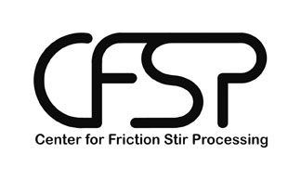
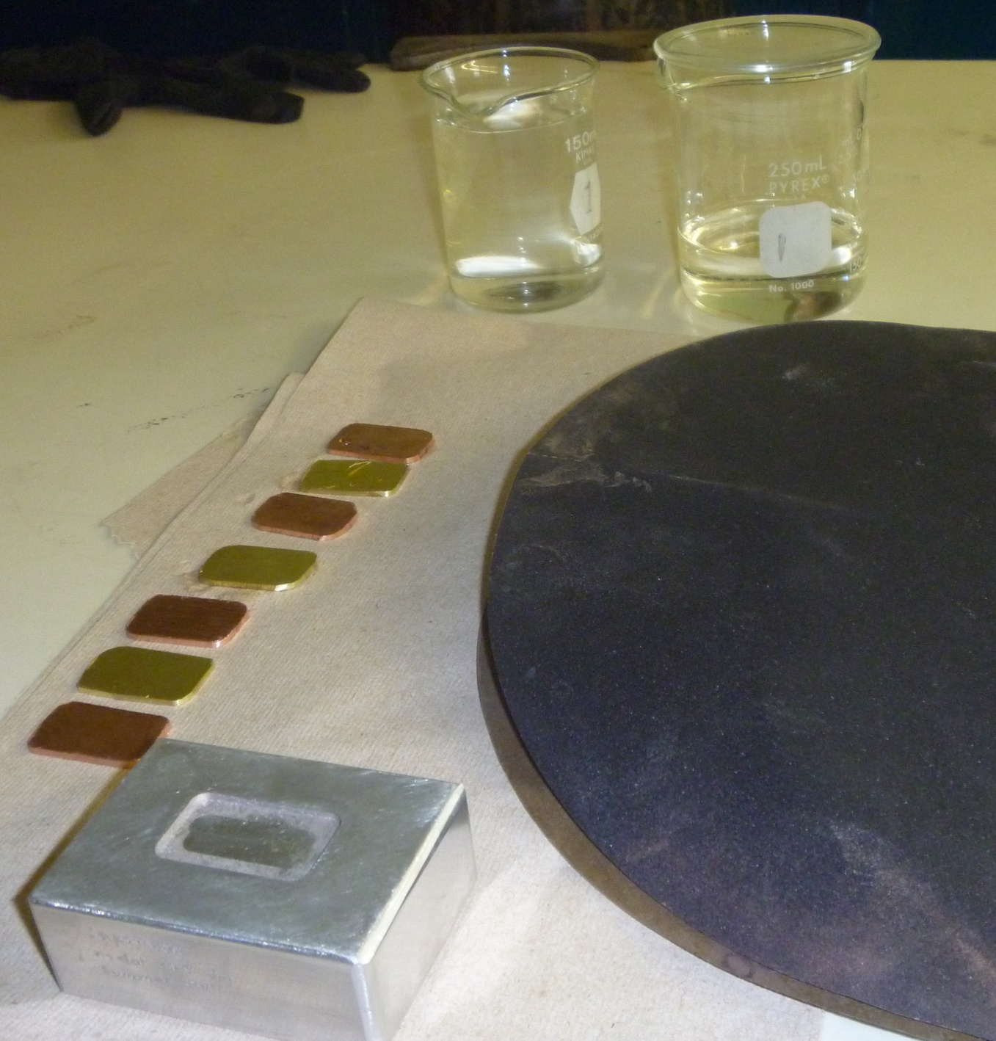
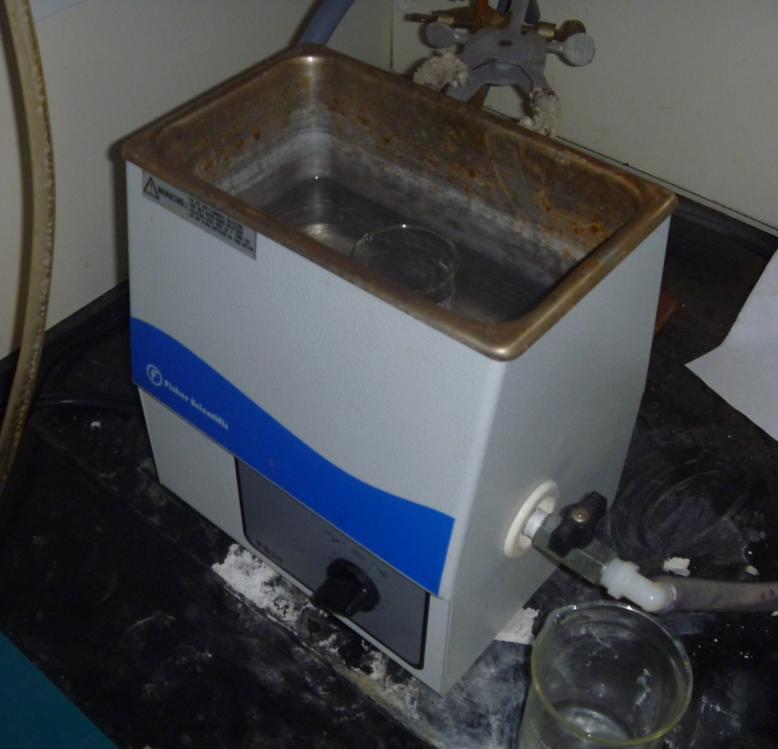
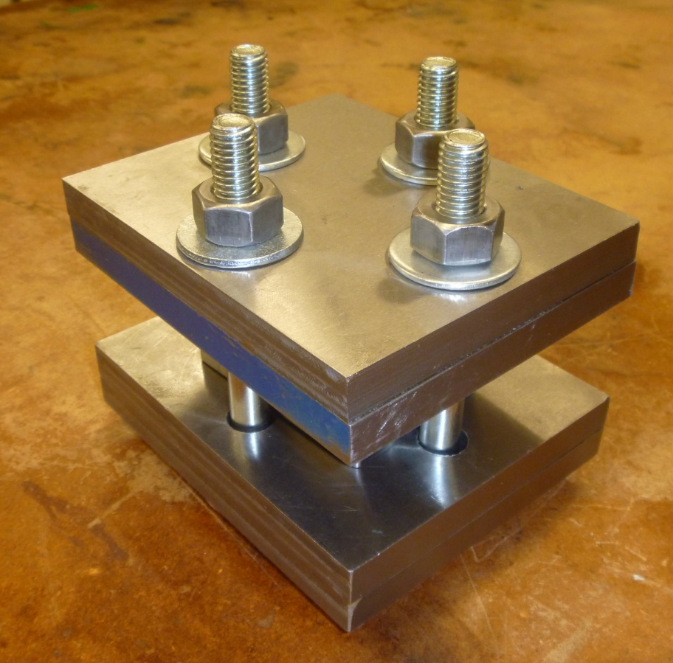
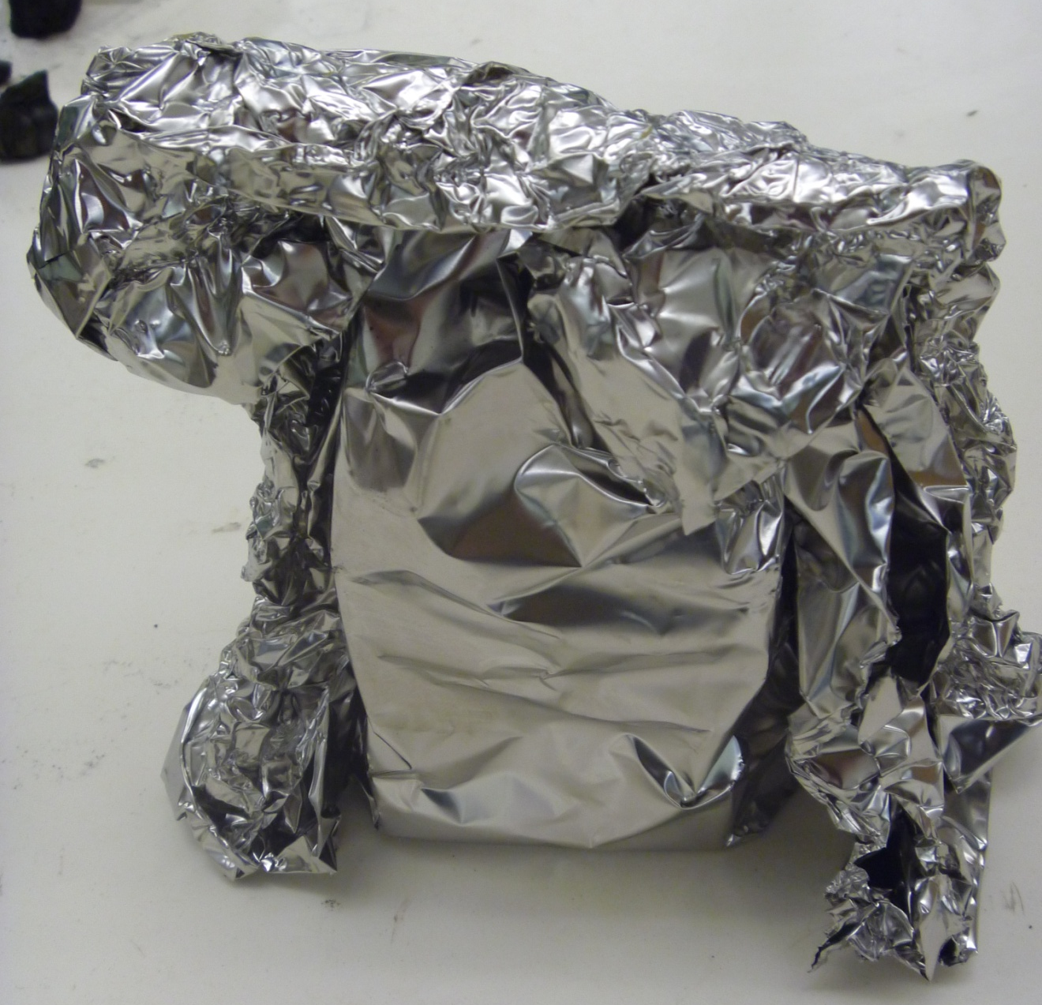
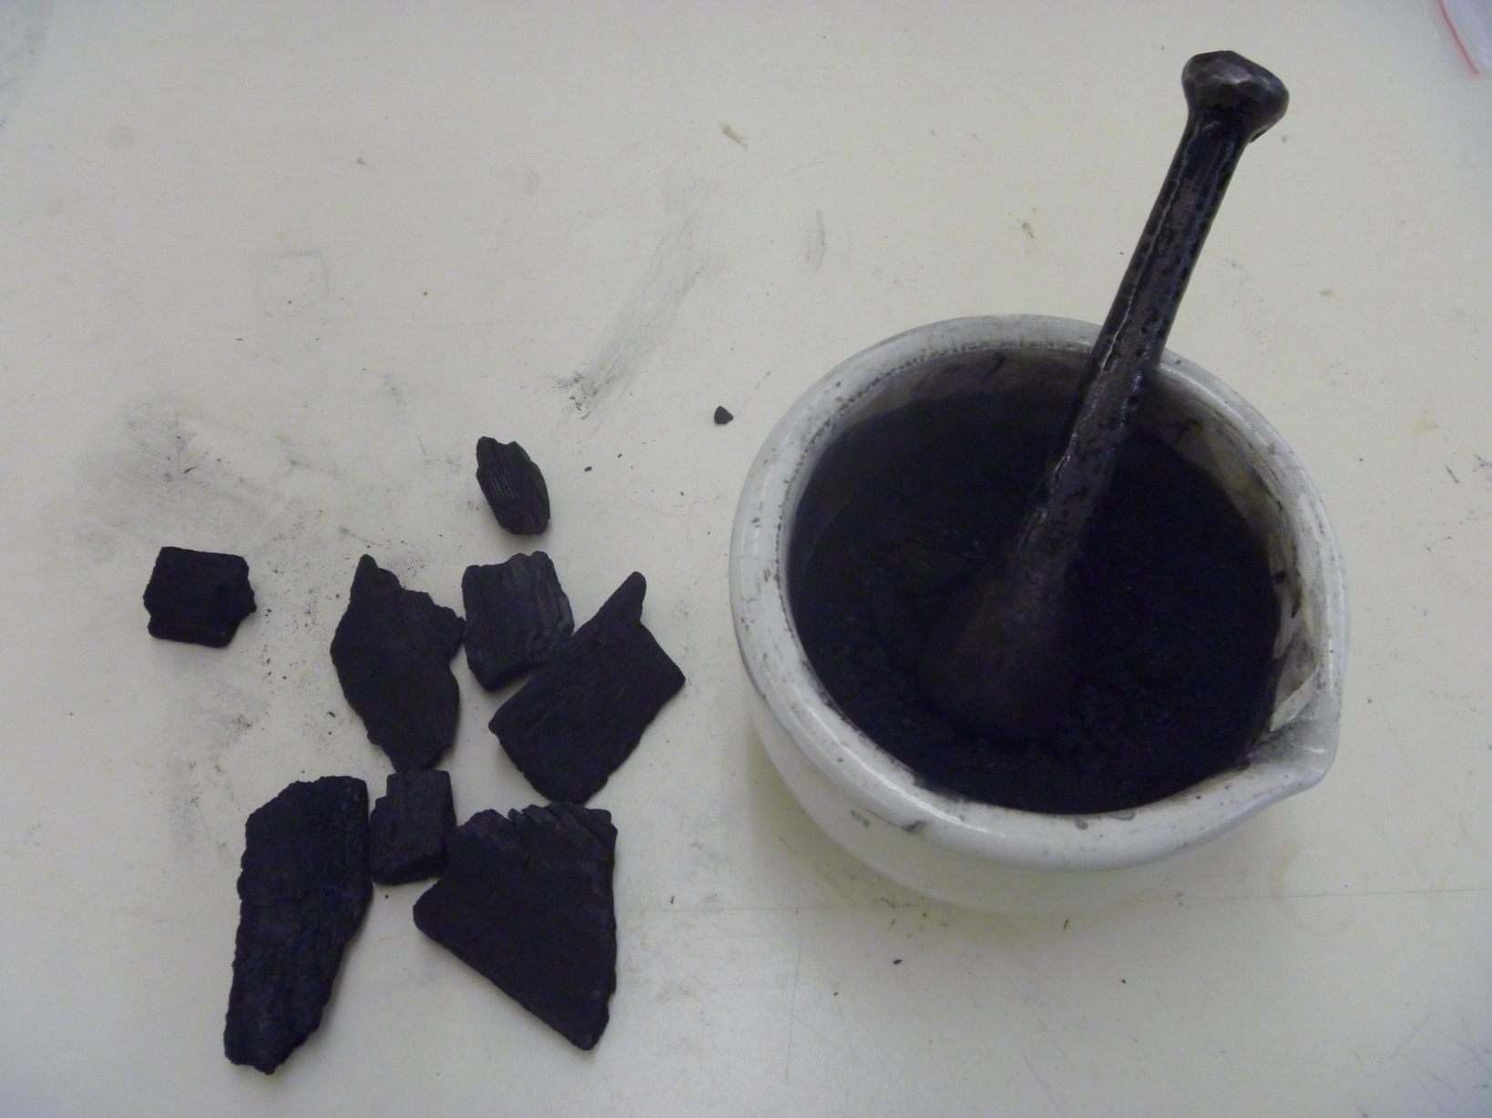
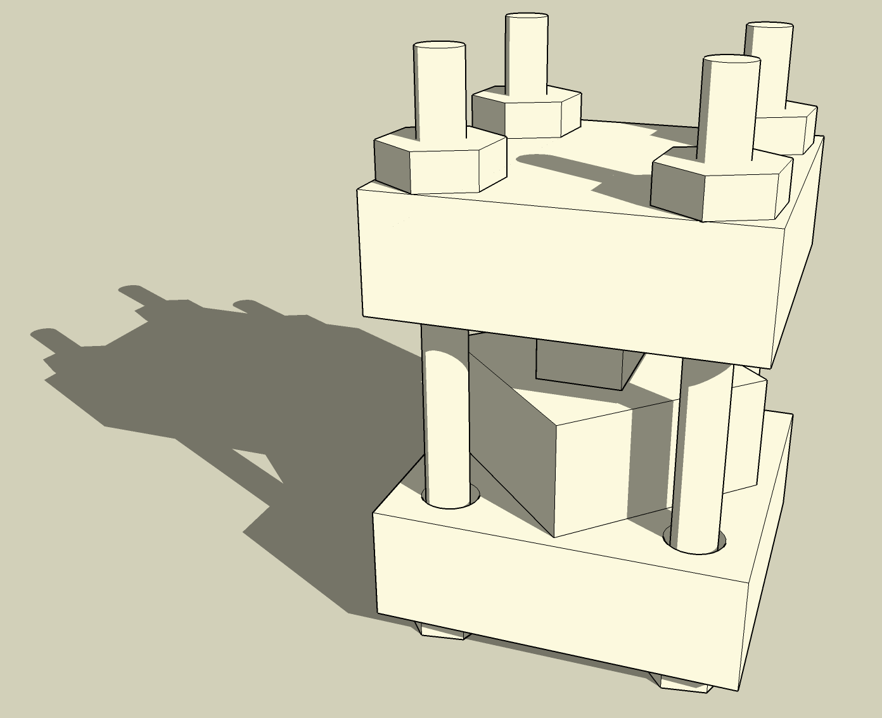
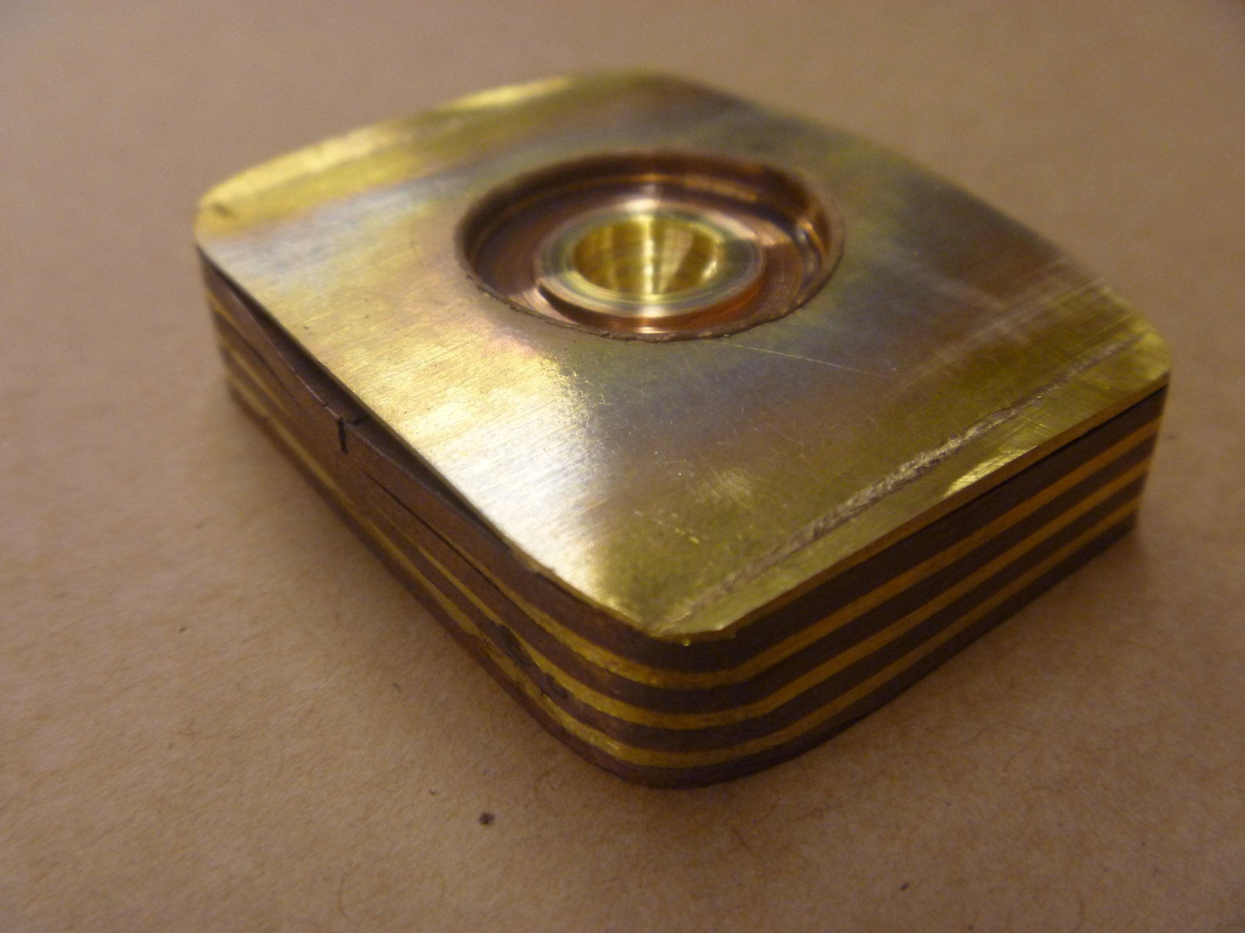
The Aesthetics of Mokumè Ganè
Eric Olson, Dr. Michael West
Research Made
Possible by NSF REU Grant #0852057
ABSTRACT
OBJECTIVES
RESULTS
To create a mokumè ganè billet
To investigate current and historic methods for creating mokumè ganè
To examine the aesthetics of mokumè ganè that has been patterned using Friction Stir Processing
Mokumè ganè is a traditional, decorative metalworking technique of Japan. This solid-state process utilizes diffusion bonding to join dissimilar metals without adhesive or solder. In this study, attempts are made to successfully create mokumè ganè, and examine the aesthetic effects of Friction Stir Processing on the mokumè ganè formed.
The resulting billets were thoroughly bonded, however, because of the different mechanical properties of the metals, the bond was still subject to failure under cold work and even hot rolling
During Friction stir processing, the top plate of the billet was consistently broken
Loose plates and a bonded billet were Friction Stir Processed, this successfully generated new patterns in the samples
When cut, the cross sections revealed additional patterns.
PROCEDURE
Sample Preparation
The plates were cleaned using a combination of acetone, sanding, and ultrasonic baths
The plates were stacked and clamped in the press shown below
The assembly was wrapped in a stainless steel foil bag that was filled with granulated charcoal to absorb oxygen
Sample Processing
Various methods were used, such as cold rolling, hammering, hot rolling, and Friction Stir Processing to work and pattern the billet
FUTURE WORK
Investigate how other metals react to mokumè ganè and Friction Stir Processing
Decrease failure rate and isolate the factors that encourage delamination
Attempt other combinations of Friction Stir Processing and hot work to create more intricate patterns
Figure 2: mokumè ganè procedure
CONCLUSIONS
While brass-copper mokumè ganè is easily bonded with proper technique, it is very difficult to work, and cold rolling mokumè ganè should only be performed with very ductile metals
Friction Stir Processing has potential use as an additional patterning tool in mokumè ganè
Plunge welds are more visually appealing than linear welds
Thicker plates showed distortions from stir welding better
The stirred region could potentially act as an extra color
Figure 1: mokumè ganè press
Figure 3: processed mokumè ganè

